Slide 1
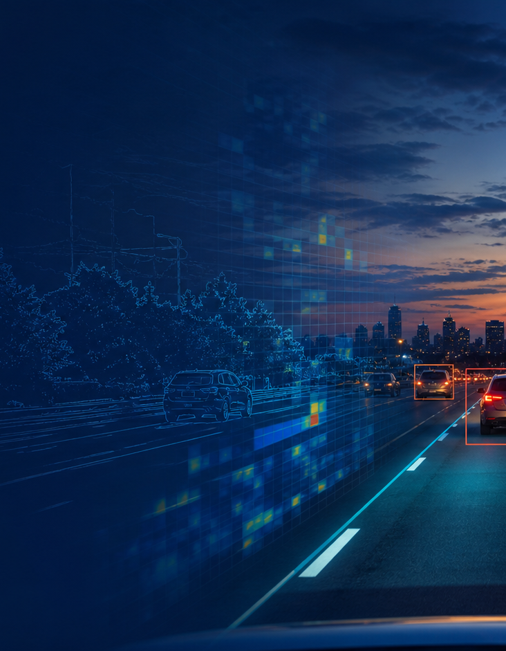
CISC 647
Perception:
Classical Computer
Vision
LECTURE PERCEPTION
Digits → morphology → edges → lanes
Fall 2026
Notes:
Today is one causal story. We begin with the simplest feature that can recognize a clean digit. Every failure motivates the next operation, and every operation has a ROS 2 experiment immediately after it.
[Sources]
- /media/william/blueicedrive/Github/Intro2AV-CourseContent/2026/Presentations/Lecture 8.pptx
- /media/william/blueicedrive/Github/Intro2AV-CourseContent/2026/Presentations/Lecture 2.pptx.pdf
- OpenAI ImageGen: autonomous-driving perception hero illustration

Slide 2
One question carries us from digits to roads
LEARNING PATH
Projection
counts
Local mask
repair
Local edge
maps
Sobel +
Canny
Lines +
curves
Each limitation motivates the next tool; each tool is tested before we move on.
Notes:
Preview the entire causal chain. Do not teach these as an API list. Ask students what information the current representation loses before revealing the next method.
[Sources]
- /media/william/blueicedrive/Github/Intro2AV-CourseContent/2026/Presentations/Lecture 2.pptx.pdf
- /media/william/blueicedrive/Github/Intro2AV-CourseContent/2026/Labs/ClassicalCV/student/ROS2_HANDS_ON.md
- /media/william/blueicedrive/Github/Intro2AV-CourseContent/2026/Labs/ClassicalCV/student/DATA_README.md

Slide 3
Setup 1: download and unpack the student files
ROS 2 + OPENCV SETUP
# 1) Download ClassicalCV_student.zip to ~/Downloads
# 2) Open a terminal and unpack it
mkdir -p ~/cisc647
unzip ~/Downloads/ClassicalCV_student.zip -d ~/cisc647
# 3) Enter the lab root and check its folders
cd ~/cisc647/cv_lab
ls
Expected short folder
~/cisc647/
└── cv_lab/
├── inputs/
├── msg/
├── outputs/
└── ws/src/cv_lab/
Windows + WSL
Copy the ZIP into the Linux filesystem first. Avoid long OneDrive or /mnt/c paths.
Open ClassicalCV_student.zip in Google Drive
Notes:
Have students download the archive through the clickable button, unpack it under a short Linux path, and inspect the top-level folders. The archive opens as cv_lab and already contains the starter package under ws/src/cv_lab. Nothing is submitted. On WSL, building inside the Linux filesystem avoids long-path and permission problems.
[Sources]
- https://drive.google.com/file/d/15JSaotsxEXHAcFdtfUTNPBkq8JsG8RKH/view?usp=drivesdk
- /media/william/blueicedrive/Github/Intro2AV-CourseContent/2026/Labs/ClassicalCV/student/README.md

Slide 4
Setup 2: let rosdep install OpenCV and NumPy
ROS 2 + OPENCV SETUP
# 1) Source ROS 2
source /opt/ros/humble/setup.bash
# 2) Install rosdep, colcon, and unzip
sudo apt update
sudo apt install -y python3-rosdep \
python3-colcon-common-extensions unzip
# 3) Initialize rosdep once; continue if already initialized
sudo rosdep init
rosdep update
# 4) Install dependencies declared by cv_lab
cd ~/cisc647/cv_lab/ws
rosdep install --from-paths src --ignore-src -r -y
Key lab dependencies
python3-opencv • python3-numpy
rclpy • std_msgs
ament_index_python
launch • launch_ros
5) Verify before building
which python3
python3 -c "import cv2,numpy,rclpy; \
print(cv2.__version__)"
If Python points to Anaconda/Miniconda: conda deactivate, then source ROS 2 again.
Notes:
OpenCV's Python import name is cv2; the Ubuntu dependency that provides it is python3-opencv. rosdep reads package.xml and installs missing system dependencies. sudo rosdep init is a one-time machine step: skip it if rosdep reports that initialization already exists. If the verification imports fail and which python3 points to Conda, deactivate Conda before sourcing Humble because the ROS binary was built for Ubuntu's system Python.
[Sources]
- https://docs.ros.org/en/humble/Installation/Ubuntu-Install-Debs.html
- https://docs.ros.org/en/humble/Tutorials/Intermediate/Rosdep.html
- /media/william/blueicedrive/Github/Intro2AV-CourseContent/2026/Labs/ClassicalCV/student/ws/src/cv_lab/package.xml
- /media/william/blueicedrive/Github/Intro2AV-CourseContent/2026/Labs/ClassicalCV/student/README.md

Slide 5
Setup 3: create a practice node, then build cv_lab
ROS 2 PACKAGE PRACTICE
A. Create cv_practice separately
B. Finish the TODOs, then rebuild cv_lab
# 1) Make a separate scratch workspace
source /opt/ros/humble/setup.bash
mkdir -p ~/pkg_practice/src
cd ~/pkg_practice/src
# 2) Create a Python package and starter node
ros2 pkg create cv_practice \
--build-type ament_python --license Apache-2.0 \
--node-name practice_node \
--dependencies rclpy std_msgs ament_index_python
# 3) Inspect what ROS created
find cv_practice -maxdepth 2 -type f
# 1) After finishing the TODOs in a Python file
source /opt/ros/humble/setup.bash
cd ~/cisc647/cv_lab/ws
# 2) Rebuild the ROS 2 package
colcon build --symlink-install \
--packages-select cv_lab
# 3) Use the rebuilt package
source install/setup.bash
cd ..
ros2 pkg executables cv_lab
Expected: 5 executables
digit_recognizer_node • digit_recognizer_morphology
digit_kernel_node • digit_edge_node • lane_detector_node
For every hands-on: open 3 terminals in ~/cisc647/cv_lab. In EACH terminal, source ROS 2 and ws/install/setup.bash.
Notes:
Students create cv_practice and its generated practice_node in a separate scratch workspace to learn what ros2 pkg create produces. Then they edit the TODOs in the downloaded cv_lab package. After they finish the TODOs in a Python file, they use the blue block to rebuild cv_lab and source the rebuilt workspace before running that node. Explain package.xml as dependency metadata, setup.py as Python packaging plus console entry points, and cv_lab/ as the importable module. Before each checkpoint, every new terminal must be in the lab root and source both the ROS underlay and ws/install/setup.bash.
[Sources]
- https://docs.ros.org/en/humble/Tutorials/Beginner-Client-Libraries/Creating-Your-First-ROS2-Package.html
- https://docs.ros.org/en/humble/Tutorials/Beginner-Client-Libraries/Writing-A-Simple-Py-Publisher-And-Subscriber.html
- /media/william/blueicedrive/Github/Intro2AV-CourseContent/2026/Labs/ClassicalCV/student/ws/src/cv_lab/package.xml
- /media/william/blueicedrive/Github/Intro2AV-CourseContent/2026/Labs/ClassicalCV/student/ws/src/cv_lab/setup.py
- /media/william/blueicedrive/Github/Intro2AV-CourseContent/2026/Labs/ClassicalCV/student/README.md

Slide 6
Our first image is a 10×10 binary matrix
PIXELS AS DATA
INPUT
100 integers in row order
ROS TOPIC
/perception/digit_matrix
Int32MultiArray
GOAL
publish a digit; echo the predicted number
index = row × 10 + column
Before recognizing a digit, decide what information to keep from its pixels.
Notes:
Read a few cells, flatten by rows, and connect the concrete matrix to the ROS message. The input is deliberately small enough to inspect by eye.
[Sources]
- /media/william/blueicedrive/Github/Intro2AV-CourseContent/2026/Labs/ClassicalCV/student/inputs/digit_3.csv
- /media/william/blueicedrive/Github/Intro2AV-CourseContent/2026/Labs/ClassicalCV/student/DATA_README.md
- /media/william/blueicedrive/Github/Intro2AV-CourseContent/2026/Labs/ClassicalCV/student/ws/src/cv_lab/cv_lab/digit_recognizer_node.py

Slide 7
Naive feature: count foreground pixels along x and y
PROJECTION HISTOGRAMS
x histogram: count each column
y histogram: count each row
100 pixels become 20 counts: compact and explainable, but much shape is discarded.
Notes:
Use x histogram to mean counts at each x coordinate, so sum down each column. Use y histogram to mean counts at each y coordinate, so sum across each row. State this convention explicitly because row/column naming often causes confusion.
[Sources]
- /media/william/blueicedrive/Github/Intro2AV-CourseContent/2026/Labs/ClassicalCV/student/inputs/digit_3.csv
- /media/william/blueicedrive/Github/Intro2AV-CourseContent/2026/Labs/ClassicalCV/answers/ws/src/cv_lab/cv_lab/digit_recognizer_node.py

Slide 8
Recognition means: compare 20 counts with ten templates
NEAREST TEMPLATE
received
10×10
x + y
counts
L1 distance
to 0…9
best match
or tie
publish digit
or −1
distance = Σ |received count − template count|
Equal best distances are ambiguous: publish −1 instead of silently choosing one digit.
Notes:
This is a nearest-template classifier, not machine learning. Work one count difference and sum absolute values. A unique distance-zero match is clean success; equal minima must be reported as ambiguity. The limitation comes from the descriptor, not from ROS.
[Sources]
- /media/william/blueicedrive/Github/Intro2AV-CourseContent/2026/Labs/ClassicalCV/answers/ws/src/cv_lab/cv_lab/digit_recognizer_node.py
- /media/william/blueicedrive/Github/Intro2AV-CourseContent/2026/Labs/ClassicalCV/student/DATA_README.md

Slide 9
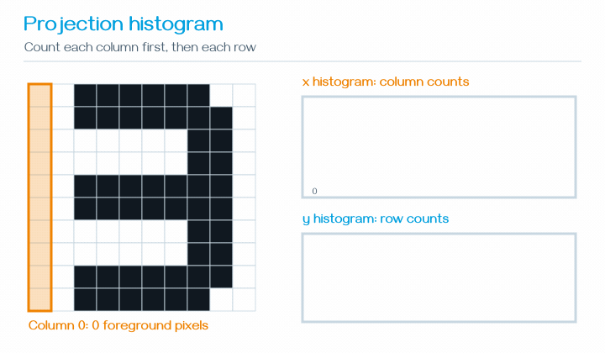
Hands-on 1: run and inspect the ROS graph yourself
HANDS-ON CHECKPOINT
EDIT: ws/src/cv_lab/cv_lab/
digit_recognizer_node.py
TODOs: HIST-ROS • HIST-CV • HIST-PUB
Finish TODOs → rebuild + source → run 1–3.
# 1) TERMINAL 1 — start node; leave running
ros2 run cv_lab digit_recognizer_node --ros-args \
-p output_dir:="$PWD/outputs"
# 2) TERMINAL 2 — inspect; then wait for one report
ros2 node list
ros2 topic list -t
ros2 topic info /perception/digit_matrix --verbose
ros2 topic echo --once /perception/digit_report
# 3) TERMINAL 3 — publish digit 3
ros2 topic pub --once /perception/digit_matrix \
std_msgs/msg/Int32MultiArray "$(cat msg/d3.yaml)"
Echo contains prediction=3, ambiguous=false, distance=0 • Open outputs/histogram_digit.png
Notes:
Students edit the exact path shown and complete the three labeled TODO sections. They then rebuild cv_lab and source the rebuilt workspace with the blue block on Setup 3 before using three sourced terminals in the numbered order. Step 1 stays running. Step 2 inspects the graph and waits on echo --once. Step 3 publishes msg/d3.yaml, triggering both the node callback and the waiting echo. The node callback already contains the visualization code.
[Sources]
- /media/william/blueicedrive/Github/Intro2AV-CourseContent/2026/Labs/ClassicalCV/student/ROS2_HANDS_ON.md
- /media/william/blueicedrive/Github/Intro2AV-CourseContent/2026/Labs/ClassicalCV/student/msg/d3.yaml
- /media/william/blueicedrive/Github/Intro2AV-CourseContent/2026/Labs/ClassicalCV/student/inputs/digit_3.csv
- /media/william/blueicedrive/Github/Intro2AV-CourseContent/2026/Labs/ClassicalCV/student/ws/src/cv_lab/cv_lab/digit_recognizer_node.py
- /media/william/blueicedrive/Github/Intro2AV-CourseContent/2026/Labs/ClassicalCV/student/outputs/histogram_digit_3.png

Slide 10
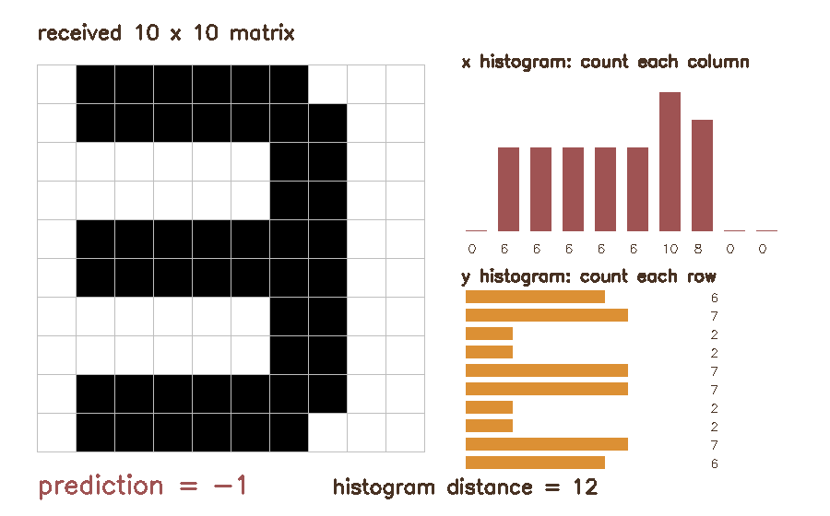
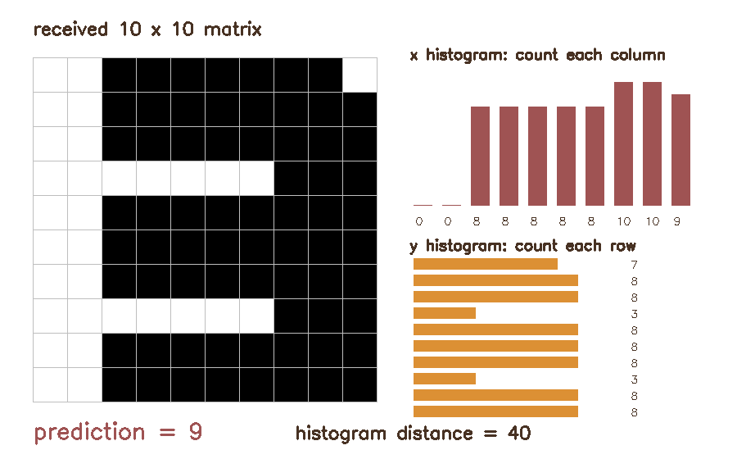
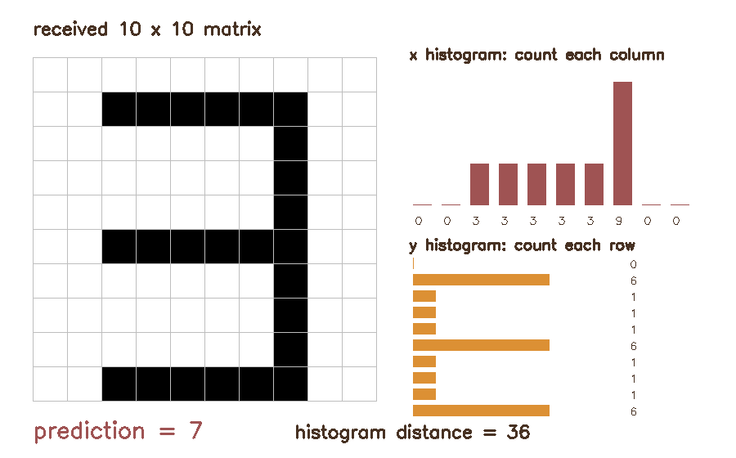
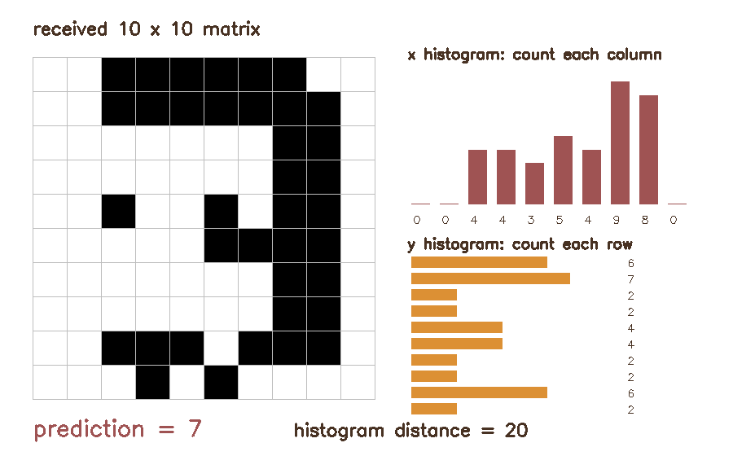
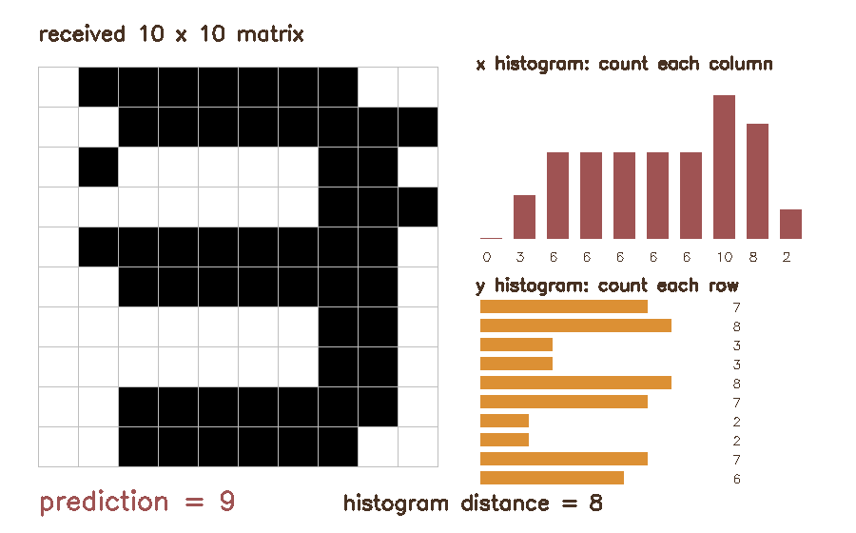
Projection counts can collide—or change under harmless variation
FAILURE CASES
Different shapes, identical x/y counts
best_matches=[2,5] → prediction=−1
digit 2
digit 5
shifted → −1
thick → 9
thin → 7
holes → 7
dots → 9
Projection histograms lose arrangement and are sensitive to shift, width, gaps, and noise.
Notes:
First compare the clean 2 and 5: they have different pixel arrangements but the same 20 projection counts, so the node reports best_matches=[2,5] and prediction=-1. Then inspect five recognizable 3s. Shift is an alignment problem; thickness, gaps, and isolated dots are local binary-mask defects.
[Sources]
- /media/william/blueicedrive/Github/Intro2AV-CourseContent/2026/Labs/ClassicalCV/student/inputs/digit_2.csv
- /media/william/blueicedrive/Github/Intro2AV-CourseContent/2026/Labs/ClassicalCV/student/inputs/digit_5.csv
- /media/william/blueicedrive/Github/Intro2AV-CourseContent/2026/Labs/ClassicalCV/student/inputs/digit_variants/digit_3_shifted.csv
- /media/william/blueicedrive/Github/Intro2AV-CourseContent/2026/Labs/ClassicalCV/student/inputs/digit_variants/digit_3_thick.csv
- /media/william/blueicedrive/Github/Intro2AV-CourseContent/2026/Labs/ClassicalCV/student/inputs/digit_variants/digit_3_thin.csv
- /media/william/blueicedrive/Github/Intro2AV-CourseContent/2026/Labs/ClassicalCV/student/inputs/digit_variants/digit_3_holes.csv
- /media/william/blueicedrive/Github/Intro2AV-CourseContent/2026/Labs/ClassicalCV/student/inputs/digit_variants/digit_3_dots.csv
- /media/william/blueicedrive/Github/Intro2AV-CourseContent/2026/Labs/ClassicalCV/answers/ws/src/cv_lab/cv_lab/digit_recognizer_node.py

Slide 11
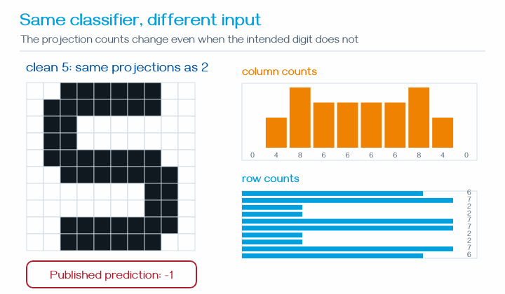
Hands-on 2A: test collision, shift, and thickness
HANDS-ON CHECKPOINT
NO CODE CHANGE • KEEP the Hands-on 1 node running • USE one input at a time
Use Terminals 1 and 2 once. In Terminal 3, run step 3, inspect it, then run 4, then 5.
# 1) TERMINAL 1 — confirm one /digit_recognizer is running
ros2 node list
# 2) TERMINAL 2 — show every report; leave running
ros2 topic echo /perception/digit_report
# 3) TERMINAL 3 — clean 5: histogram collision
ros2 topic pub --once /perception/digit_matrix \
std_msgs/msg/Int32MultiArray "$(cat msg/d5.yaml)"
# 4) TERMINAL 3 — shifted 3
ros2 topic pub --once /perception/digit_matrix \
std_msgs/msg/Int32MultiArray "$(cat msg/d3_shift.yaml)"
# 5) TERMINAL 3 — thick 3
ros2 topic pub --once /perception/digit_matrix \
std_msgs/msg/Int32MultiArray "$(cat msg/d3_thick.yaml)"
Animated preview — reproduce it with the ROS 2 steps
Steps 3–5 predict −1, −1, 9 • Inspect outputs/histogram_digit.png after EACH step • Continue to 2B
Notes:
The GIF plays in Slide Show mode and previews the three failure cases. Students keep the single digit_recognizer process from Hands-on 1; starting another copy would duplicate reports. Terminal 2 displays every report. In Terminal 3, students execute one numbered publish command, inspect that report and outputs/histogram_digit.png, and only then continue. The fixed filename is overwritten by the next input. They leave Terminals 1 and 2 running for Hands-on 2B.
[Sources]
- /media/william/blueicedrive/Github/Intro2AV-CourseContent/2026/Labs/ClassicalCV/student/ROS2_HANDS_ON.md
- /media/william/blueicedrive/Github/Intro2AV-CourseContent/2026/Labs/ClassicalCV/student/msg/d5.yaml
- /media/william/blueicedrive/Github/Intro2AV-CourseContent/2026/Labs/ClassicalCV/student/msg/d3_shift.yaml
- /media/william/blueicedrive/Github/Intro2AV-CourseContent/2026/Labs/ClassicalCV/student/msg/d3_thick.yaml
- /media/william/blueicedrive/Github/Intro2AV-CourseContent/2026/Labs/ClassicalCV/student/outputs/hist_collision_5.png

Slide 12
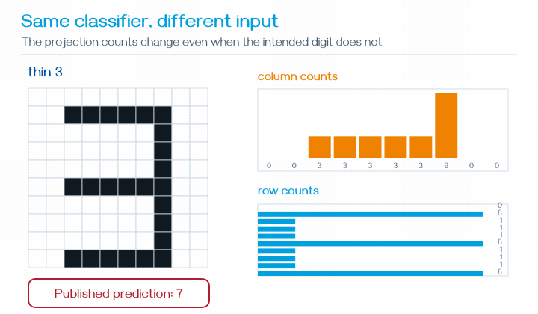
Hands-on 2B: test thin strokes, holes, and dots
HANDS-ON CHECKPOINT
KEEP the same node and echo running • USE Terminal 3 • TEST one input at a time
Run step 6, inspect the report and PNG, then run 7, then 8. Stop both running processes at step 9.
# 6) TERMINAL 3 — thin 3
ros2 topic pub --once /perception/digit_matrix \
std_msgs/msg/Int32MultiArray "$(cat msg/d3_thin.yaml)"
# 7) TERMINAL 3 — 3 with holes
ros2 topic pub --once /perception/digit_matrix \
std_msgs/msg/Int32MultiArray "$(cat msg/d3_holes.yaml)"
# 8) TERMINAL 3 — 3 with dots
ros2 topic pub --once /perception/digit_matrix \
std_msgs/msg/Int32MultiArray "$(cat msg/d3_dots.yaml)"
# 9) FINISH — press Ctrl+C in Terminal 2, then Terminal 1
Animated preview — reproduce it with the ROS 2 steps
Steps 6–8 predict 7, 7, 9 • Inspect outputs/histogram_digit.png after EACH step • Then stop
Notes:
The GIF plays in Slide Show mode and previews the three failure cases. Students continue with the same node and echo processes from Hands-on 2A. In Terminal 3, they publish one input at a time and inspect the report and overwritten PNG before moving to the next step. Step 9 stops Terminal 2 first and then Terminal 1.
[Sources]
- /media/william/blueicedrive/Github/Intro2AV-CourseContent/2026/Labs/ClassicalCV/student/ROS2_HANDS_ON.md
- /media/william/blueicedrive/Github/Intro2AV-CourseContent/2026/Labs/ClassicalCV/student/msg/d3_thin.yaml
- /media/william/blueicedrive/Github/Intro2AV-CourseContent/2026/Labs/ClassicalCV/student/msg/d3_holes.yaml
- /media/william/blueicedrive/Github/Intro2AV-CourseContent/2026/Labs/ClassicalCV/student/msg/d3_dots.yaml

Slide 13
Which failures can preprocessing repair?
FROM FAILURE TO MORPHOLOGY
Too thick
Too thin
Small dots
Small holes
shrink the foreground
grow the foreground
remove isolated foreground
bridge short background gaps
These are local binary-shape defects, so they motivate morphology—not a new classifier.
Notes:
Classify the observed failures by what should change in the binary mask. Keep the shifted 3 separate: local growing or shrinking does not know where the digit should be centered.
[Sources]
- https://docs.opencv.org/4.x/d9/d61/tutorial_py_morphological_ops.html
- /media/william/blueicedrive/Github/Intro2AV-CourseContent/2026/Labs/ClassicalCV/student/inputs/digit_variants

Slide 14
Erode shrinks; dilate grows
MORPHOLOGY
Kernel
Erode
Dilate
a small neighborhood that slides over the mask
keep a 1 only when the kernel fits foreground
write a 1 when the kernel touches foreground
Kernel shape states which neighboring pixels should count as connected.
Notes:
Use plain language first: erosion trims boundaries and dilation expands them. Then show that a horizontal kernel connects horizontally while a vertical kernel connects vertically.
[Sources]
- https://docs.opencv.org/4.x/d9/d61/tutorial_py_morphological_ops.html

Slide 15
Opening and closing are two-operation repairs
MORPHOLOGY
opening = erode → dilate
Opening
erode
remove small dots
dilate
restore main stroke
closing = dilate → erode
Closing
dilate
bridge small gaps
erode
restore thickness
Choose the operation from the defect; do not apply all four blindly.
Notes:
Opening removes foreground specks smaller than the kernel. Closing fills or bridges small background gaps. The order is the meaning; neither is a universal cleanup button.
[Sources]
- https://docs.opencv.org/4.x/d9/d61/tutorial_py_morphological_ops.html

Slide 16
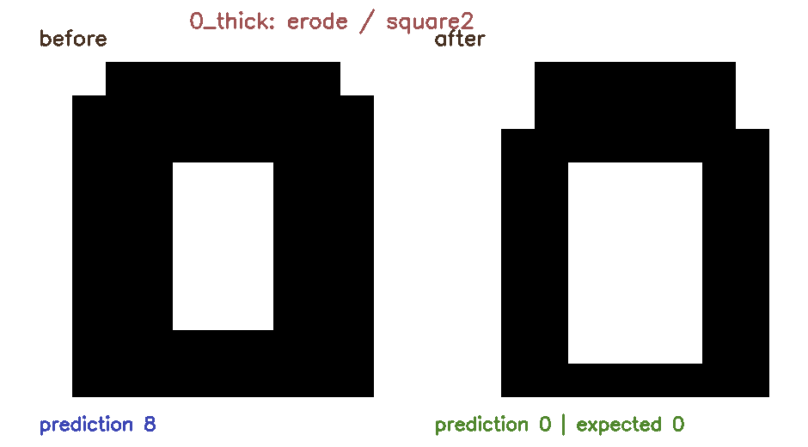
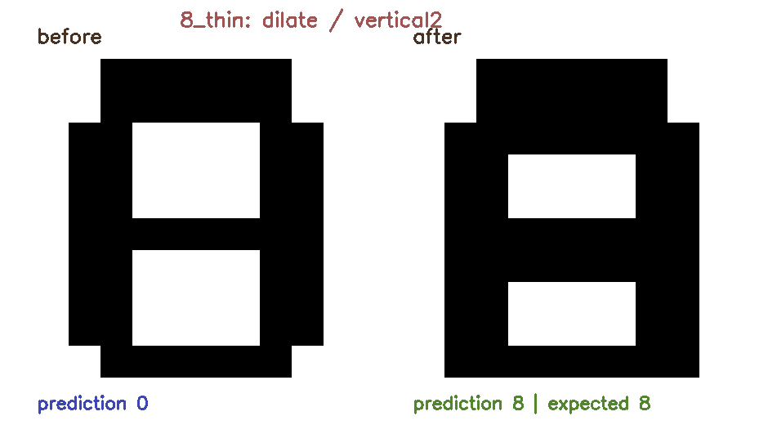
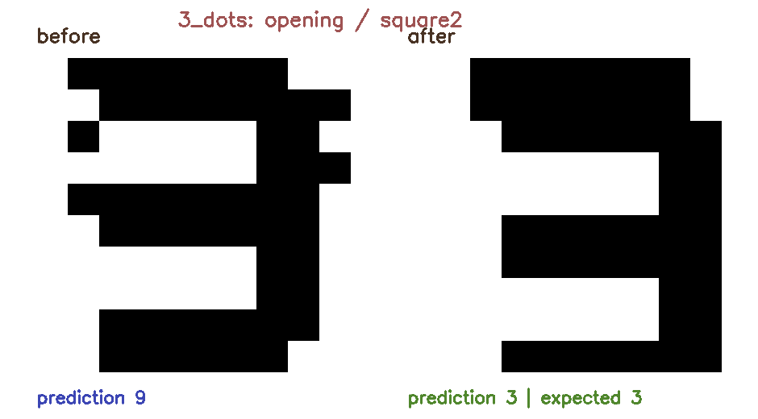
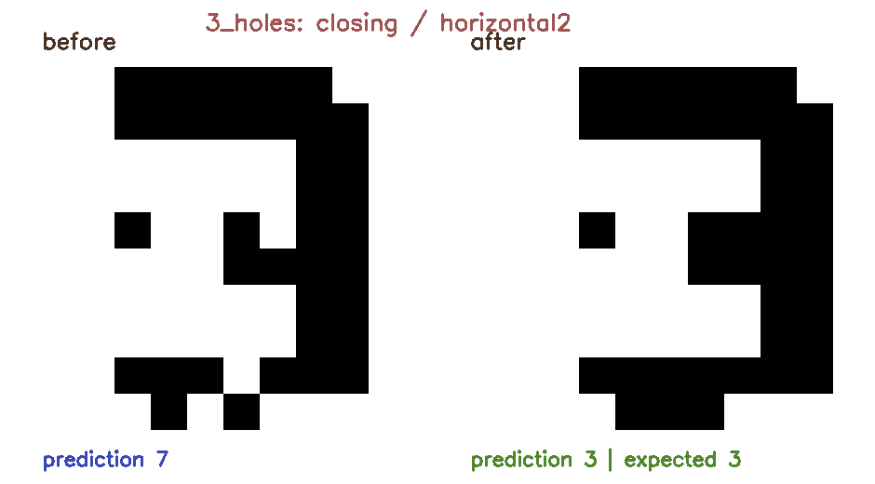
Morphology changes the nearest match for 0, 8, and 3
RESULTS
erode → 0
dilate → 8
opening → 3
closing → 3
Same histogram classifier; only the input mask changes before counting.
Notes:
Read each verified before/after prediction. The examples include three digit classes so students see morphology as a general mask operation, not a special trick for the digit 3.
[Sources]
- /media/william/blueicedrive/Github/Intro2AV-CourseContent/2026/Labs/ClassicalCV/student/outputs/morph_0_thick.png
- /media/william/blueicedrive/Github/Intro2AV-CourseContent/2026/Labs/ClassicalCV/student/outputs/morph_8_thin.png
- /media/william/blueicedrive/Github/Intro2AV-CourseContent/2026/Labs/ClassicalCV/student/outputs/morph_3_dots.png
- /media/william/blueicedrive/Github/Intro2AV-CourseContent/2026/Labs/ClassicalCV/student/outputs/morph_3_holes.png
- /media/william/blueicedrive/Github/Intro2AV-CourseContent/2026/Labs/ClassicalCV/answers/ws/src/cv_lab/cv_lab/digit_recognizer_morphology.py

Slide 17
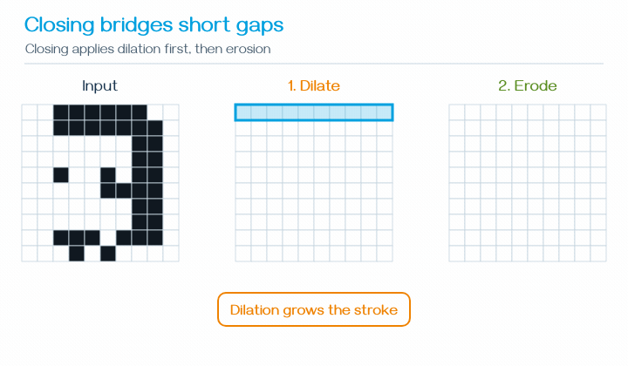
Hands-on 3: set parameters, publish, and compare
HANDS-ON CHECKPOINT
EDIT: ws/src/cv_lab/cv_lab/
digit_recognizer_morphology.py
TODOs: MORPH-ROS • MORPH-CV • MORPH-PUB
Finish TODOs → rebuild + source → run 1–5.
# 1) TERMINAL 1 — start node; leave running
ros2 run cv_lab digit_recognizer_morphology \
--ros-args -p output_dir:="$PWD/outputs"
# 2) TERMINAL 2 — wait for one 3-holes report
ros2 topic echo --once /perception/morph_digit_report
# 3) TERMINAL 3 — set all four parameters first
ros2 param set /digit_recognizer_morphology operation closing
ros2 param set /digit_recognizer_morphology kernel horizontal2
ros2 param set /digit_recognizer_morphology case_name 3_holes
ros2 param set /digit_recognizer_morphology expected_digit 3
# 4) TERMINAL 3 — publish the 3-holes matrix
ros2 topic pub --once /perception/digit_matrix \
std_msgs/msg/Int32MultiArray "$(cat msg/d3_holes.yaml)"
# 5) FINISH — view PNG; Ctrl+C in Terminal 1
Echo contains before_prediction=7, prediction=3, status=PASS • Open outputs/morph_3_holes.png
Notes:
Students edit the exact path shown and complete the three labeled TODO sections. They then rebuild cv_lab and source the rebuilt workspace with the blue block on Setup 3 before using three sourced terminals in numbered order. They start the node, wait for one report, set all four parameters, and finally publish msg/d3_holes.yaml. The verified report fields are before_prediction=7, prediction=3, expected=3, and status=PASS. Figure writing already occurs inside the node callback. Step 5 stops Terminal 1 after viewing the result.
[Sources]
- https://docs.opencv.org/4.x/d9/d61/tutorial_py_morphological_ops.html
- /media/william/blueicedrive/Github/Intro2AV-CourseContent/2026/Labs/ClassicalCV/student/ROS2_HANDS_ON.md
- /media/william/blueicedrive/Github/Intro2AV-CourseContent/2026/Labs/ClassicalCV/student/msg/d3_holes.yaml
- /media/william/blueicedrive/Github/Intro2AV-CourseContent/2026/Labs/ClassicalCV/student/ws/src/cv_lab/cv_lab/digit_recognizer_morphology.py
- /media/william/blueicedrive/Github/Intro2AV-CourseContent/2026/Labs/ClassicalCV/student/outputs/morph_3_holes.png

Slide 18
Morphology repairs masks; edge maps preserve boundary arrangement
WHY MOVE TO EDGES?
Morphology
Projection counts
Local edge maps
repairs selected local thickness, speck, and gap defects
still discard where boundary pieces occur
retain where horizontal and vertical changes occur
Alignment is separate: the later edge node supplies simple centering for translation.
Notes:
Do not imply that morphology solves translation or that basic edge matching is automatically translation invariant. Morphology handles selected local mask defects. Projection counts still lose boundary arrangement, so local edge maps are the next representation. The later edge node recenters the foreground box as a separate classical alignment step.
[Sources]
- https://docs.opencv.org/4.x/d9/d61/tutorial_py_morphological_ops.html
- /media/william/blueicedrive/Github/Intro2AV-CourseContent/2026/Labs/ClassicalCV/student/inputs/digit_variants/digit_3_shifted.csv
- /media/william/blueicedrive/Github/Intro2AV-CourseContent/2026/Labs/ClassicalCV/answers/ws/src/cv_lab/cv_lab/digit_edge_node.py

Slide 19
A kernel asks one local question by multiply-and-sum
BASIC EDGE KERNELS
place 3×3
on a patch
multiply
matching cells
add all
products
large value =
pattern found
response[y,x] = Σ kernel[i,j] × image[y+i,x+j]
Unlike a histogram, a kernel preserves where a local brightness change occurs.
Notes:
Work a small multiply-and-add example. A negative response means the opposite brightness direction; taking absolute value keeps edge strength when direction is not needed.
[Sources]
- https://docs.opencv.org/4.x/d2/d2c/tutorial_sobel_derivatives.html
- /media/william/blueicedrive/Github/Intro2AV-CourseContent/2026/Labs/ClassicalCV/answers/ws/src/cv_lab/cv_lab/digit_kernel_node.py

Slide 20
Two simple kernels reveal vertical and horizontal boundaries
BASIC EDGE KERNELS
left-right change → vertical edge
top-bottom change → horizontal edge
-1
0
1
-1
-1
-1
-1
0
1
0
0
0
-1
0
1
1
1
1
The direction we compare is perpendicular to the visible edge.
Store both response maps and compare them with edge templates for digits 0–9.
Notes:
Name the common orientation ambiguity carefully. A left-right derivative responds to a vertical boundary; a top-bottom derivative responds to a horizontal boundary.
[Sources]
- https://docs.opencv.org/4.x/d2/d2c/tutorial_sobel_derivatives.html
- /media/william/blueicedrive/Github/Intro2AV-CourseContent/2026/Labs/ClassicalCV/student/ws/src/cv_lab/cv_lab/digit_kernel_node.py

Slide 21
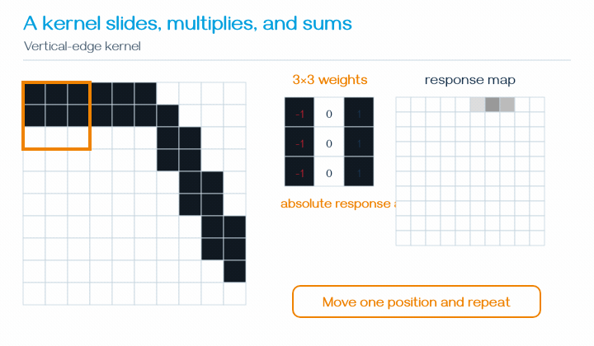
Hands-on 4: publish slanted and curved digits
HANDS-ON CHECKPOINT
EDIT: ws/src/cv_lab/cv_lab/
digit_kernel_node.py
TODOs: KERNEL-ROS • KERNEL-CV • KERNEL-PUB
Finish TODOs → rebuild + source → run 1–5.
# 1) TERMINAL 1 — start node; leave running
ros2 run cv_lab digit_kernel_node --ros-args \
-p output_dir:="$PWD/outputs"
# 2) TERMINAL 2 — show both reports; leave running
ros2 topic echo /perception/kernel_digit_report
# 3) TERMINAL 3 — publish the slanted 7; view PNG
ros2 topic pub --once /perception/digit_matrix \
std_msgs/msg/Int32MultiArray "$(cat msg/d7_slant.yaml)"
# 4) TERMINAL 3 — publish the curved 3; refresh PNG
ros2 topic pub --once /perception/digit_matrix \
std_msgs/msg/Int32MultiArray "$(cat msg/d3_curve.yaml)"
# 5) FINISH — Ctrl+C in Terminals 2 and 1
Reports: slanted 7→1, then curved 3→3 • Each run replaces outputs/kernel_digit.png
Notes:
Students edit the exact path shown and complete the labeled TODO sections. They then rebuild cv_lab and source the rebuilt workspace with the blue block on Setup 3 before using three sourced terminals. Terminal 2 displays both reports. After step 3, students open outputs/kernel_digit.png before step 4 replaces it; after step 4, they refresh the file. Step 5 stops the two persistent processes.
[Sources]
- /media/william/blueicedrive/Github/Intro2AV-CourseContent/2026/Labs/ClassicalCV/student/ROS2_HANDS_ON.md
- /media/william/blueicedrive/Github/Intro2AV-CourseContent/2026/Labs/ClassicalCV/student/msg/d7_slant.yaml
- /media/william/blueicedrive/Github/Intro2AV-CourseContent/2026/Labs/ClassicalCV/student/msg/d3_curve.yaml
- /media/william/blueicedrive/Github/Intro2AV-CourseContent/2026/Labs/ClassicalCV/student/ws/src/cv_lab/cv_lab/digit_kernel_node.py
- /media/william/blueicedrive/Github/Intro2AV-CourseContent/2026/Labs/ClassicalCV/student/outputs/kernel_shape_7_slanted.png

Slide 22
But handwriting contains diagonal and curved strokes
WHY BASIC KERNELS ARE NOT ENOUGH
Only two directions
Many possible directions
Sobel measures any direction; Canny thins supported edges; Hough groups straight pieces.
Notes:
Connect directly to the previous result: the same slanted 7 was predicted as 1 by the basic-kernel descriptor. Sobel magnitude combines horizontal and vertical change, Canny selects thin connected edge pixels, and Hough groups only locally straight pieces. Curves still require another model.
[Sources]
- https://docs.opencv.org/4.x/d2/d2c/tutorial_sobel_derivatives.html
- https://docs.opencv.org/4.x/da/d22/tutorial_py_canny.html
- https://docs.opencv.org/4.x/d9/db0/tutorial_hough_lines.html
- /media/william/blueicedrive/Github/Intro2AV-CourseContent/2026/Labs/ClassicalCV/student/inputs/digit_variants/digit_7_slanted.csv

Slide 23
Sobel combines left-right and top-bottom change
SOBEL
Gx
Gy
Magnitude
Direction
left-right brightness change
top-bottom brightness change
sqrt(Gx² + Gy²)
edge strength
atan2(Gy,Gx)
change direction
A diagonal edge activates both Gx and Gy; magnitude keeps the combined strength.
Notes:
Explain Sobel as a weighted version of the two basic directional kernels. Introduce the equations only after the left-right/top-bottom intuition.
[Sources]
- https://docs.opencv.org/4.x/d2/d2c/tutorial_sobel_derivatives.html

Slide 24
Canny turns many noisy responses into thin connected edges
CANNY
blur
reduce noise
Sobel
find change
thin
keep local peaks
two thresholds
strong + weak
connect
keep supported weak
Low thresholds keep clutter; high thresholds lose strokes. Inspect the edge image before tuning Hough.
Notes:
Canny is a pipeline built on gradients. Explain hysteresis in plain terms: a weak edge survives when connected to a strong edge.
[Sources]
- https://docs.opencv.org/4.x/da/d22/tutorial_py_canny.html

Slide 25
Hough groups straight edge pixels—not curves
HOUGH LINE DETECTION
Canny
edge pixels
each pixel
proposes lines
shared lines
collect votes
high votes
become segments
cv2.HoughLinesP(edges, rho=1, theta=np.pi/180,
threshold=22, minLineLength=22,
maxLineGap=12)
Sobel measures local change; Canny selects edge pixels; Hough groups straight evidence.
Notes:
Use the voting story before rho and theta. HoughLinesP returns endpoints, which are easier to draw and count. Emphasize that standard HoughLinesP groups straight segments, not arbitrary curves.
[Sources]
- https://docs.opencv.org/4.x/d9/db0/tutorial_hough_lines.html

Slide 26
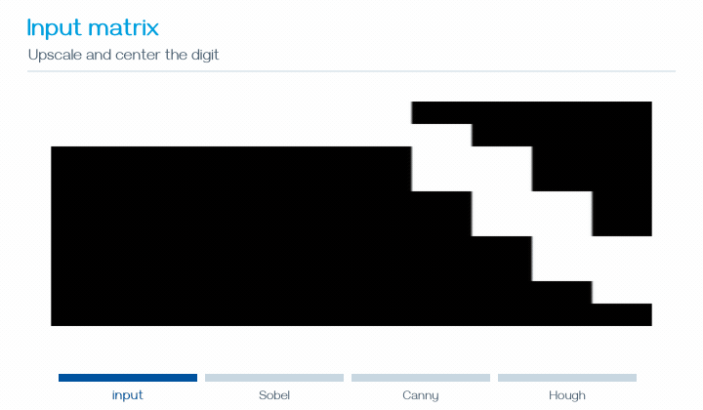
Hands-on 5: publish the same difficult shapes to a richer node
HANDS-ON CHECKPOINT
EDIT: ws/src/cv_lab/cv_lab/
digit_edge_node.py
TODOs: EDGE-ROS • EDGE-CV • EDGE-PUB
Finish TODOs → rebuild + source → run 1–5.
# 1) TERMINAL 1 — start node; leave running
ros2 run cv_lab digit_edge_node --ros-args \
-p output_dir:="$PWD/outputs"
# 2) TERMINAL 2 — show both reports; leave running
ros2 topic echo /perception/edge_digit_report
# 3) TERMINAL 3 — publish the slanted 7; view PNG
ros2 topic pub --once /perception/digit_matrix \
std_msgs/msg/Int32MultiArray "$(cat msg/d7_slant.yaml)"
# 4) TERMINAL 3 — publish the curved 3; refresh PNG
ros2 topic pub --once /perception/digit_matrix \
std_msgs/msg/Int32MultiArray "$(cat msg/d3_curve.yaml)"
# 5) FINISH — Ctrl+C in Terminals 2 and 1
Reports: 7 with 525/6, then 3 with 1048/9 Canny pixels/Hough segments • PNG is replaced
Notes:
Students edit the exact path shown and complete the labeled TODO sections. They then rebuild cv_lab and source the rebuilt workspace with the blue block on Setup 3 before using three sourced terminals. Terminal 2 displays both reports. After step 3, students open outputs/edge_digit.png before step 4 replaces it; after step 4, they refresh the file. The verified reports are prediction=7, canny_pixels=525, hough_segments=6 and prediction=3, canny_pixels=1048, hough_segments=9. Step 5 stops the two persistent processes.
[Sources]
- https://docs.opencv.org/4.x/d2/d2c/tutorial_sobel_derivatives.html
- https://docs.opencv.org/4.x/da/d22/tutorial_py_canny.html
- https://docs.opencv.org/4.x/d9/db0/tutorial_hough_lines.html
- /media/william/blueicedrive/Github/Intro2AV-CourseContent/2026/Labs/ClassicalCV/student/ROS2_HANDS_ON.md
- /media/william/blueicedrive/Github/Intro2AV-CourseContent/2026/Labs/ClassicalCV/student/msg/d7_slant.yaml
- /media/william/blueicedrive/Github/Intro2AV-CourseContent/2026/Labs/ClassicalCV/student/msg/d3_curve.yaml
- /media/william/blueicedrive/Github/Intro2AV-CourseContent/2026/Labs/ClassicalCV/student/ws/src/cv_lab/cv_lab/digit_edge_node.py
- /media/william/blueicedrive/Github/Intro2AV-CourseContent/2026/Labs/ClassicalCV/student/outputs/edge_shape_7_slanted.png

Slide 27
The same edge pipeline transfers from digits to roads
ROAD TRANSFER
road image
grayscale
+ blur
Canny
edges
road ROI
lines or
curves
Same
New
Output
local brightness boundaries
perspective and road region
lane boundary overlay + ROS report
Classical perception succeeds by adding explicit task assumptions around general edge evidence.
Notes:
Connect the digit and road pipelines directly. Canny still produces edge pixels; the road task adds a trapezoidal ROI and geometric lane constraints.
[Sources]
- https://docs.opencv.org/4.x/da/d22/tutorial_py_canny.html
- https://docs.opencv.org/4.x/d9/db0/tutorial_hough_lines.html
- /media/william/blueicedrive/Github/Intro2AV-CourseContent/2026/Labs/ClassicalCV/answers/ws/src/cv_lab/cv_lab/lane_detector_node.py

Slide 28
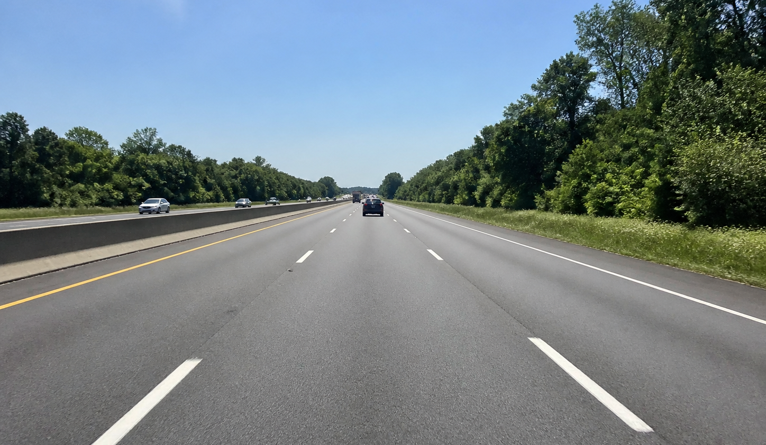
Straight lanes: ROI removes clutter; Hough returns segments
STRAIGHT LANES
Canny
trapezoid ROI
HoughLinesP
slope filter
Ignore sky, trees, and nearly horizontal texture
Hough detects line evidence; ROI and slope rules turn that evidence into lane hypotheses.
Notes:
Point out false Canny edges in trees and barriers. The ROI removes most irrelevant geometry, and slope filtering rejects implausible lane directions.
[Sources]
- https://docs.opencv.org/4.x/d9/db0/tutorial_hough_lines.html
- /media/william/blueicedrive/Github/Intro2AV-CourseContent/2026/Labs/ClassicalCV/student/inputs/road_straight.png
- /media/william/blueicedrive/Github/Intro2AV-CourseContent/2026/Labs/ClassicalCV/answers/ws/src/cv_lab/cv_lab/lane_detector_node.py

Slide 29
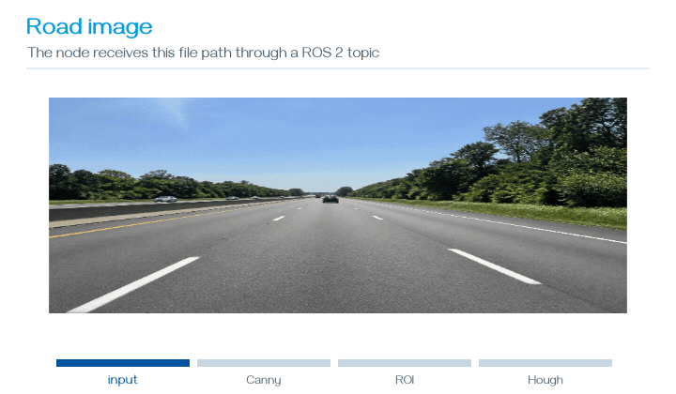
Hands-on 6: publish an image path and detect straight lanes
HANDS-ON CHECKPOINT
EDIT: ws/src/cv_lab/cv_lab/
lane_detector_node.py
TODOs: LANE-ROS • STRAIGHT-CV • LANE-PUB
Finish TODOs → rebuild + source → run 1–4.
# 1) TERMINAL 1 — start node; leave running
ros2 run cv_lab lane_detector_node --ros-args \
-p output_dir:="$PWD/outputs"
# 2) TERMINAL 2 — inspect; then wait for one report
ros2 topic info /perception/road_image_path --verbose
ros2 topic echo --once /perception/lane_report
# 3) TERMINAL 3 — publish road_straight.png
ros2 topic pub --once /perception/road_image_path \
std_msgs/msg/String "{data: '$PWD/inputs/road_straight.png'}"
# 4) FINISH — view PNG; Ctrl+C in Terminal 1
Echo contains mode=straight and hough_segments=11 • Open outputs/lane_straight.png
Notes:
Students edit the exact path shown and complete the labeled TODO sections. They then rebuild cv_lab and source the rebuilt workspace with the blue block on Setup 3 before using three sourced terminals. Terminal 2 inspects the input topic and waits for one report. Terminal 3 publishes the absolute path to inputs/road_straight.png. The verified report contains mode=straight and hough_segments=11. Step 4 stops Terminal 1 before students edit CURVE-CV.
[Sources]
- https://docs.opencv.org/4.x/da/d22/tutorial_py_canny.html
- https://docs.opencv.org/4.x/d9/db0/tutorial_hough_lines.html
- /media/william/blueicedrive/Github/Intro2AV-CourseContent/2026/Labs/ClassicalCV/student/ROS2_HANDS_ON.md
- /media/william/blueicedrive/Github/Intro2AV-CourseContent/2026/Labs/ClassicalCV/student/inputs/road_straight.png
- /media/william/blueicedrive/Github/Intro2AV-CourseContent/2026/Labs/ClassicalCV/student/ws/src/cv_lab/cv_lab/lane_detector_node.py
- /media/william/blueicedrive/Github/Intro2AV-CourseContent/2026/Labs/ClassicalCV/student/outputs/lane_straight.png

Slide 30
A curve is not one straight Hough line
CURVED-LANE LIMITATION
ONE LINE
cannot follow changing direction
SHORT LINES
approximate a curve but jitter
CURVE FIT
fit x as a smooth function of y
Keep Canny evidence; replace straight grouping with a curve fit.
Notes:
Standard HoughLinesP is a straight-segment detector. A curved lane changes tangent direction. Many segments can approximate it, but a low-order polynomial gives a smoother introductory result.
[Sources]
- https://docs.opencv.org/4.x/d9/db0/tutorial_hough_lines.html
- /media/william/blueicedrive/Github/Intro2AV-CourseContent/2026/Labs/ClassicalCV/answers/ws/src/cv_lab/cv_lab/lane_detector_node.py

Slide 31
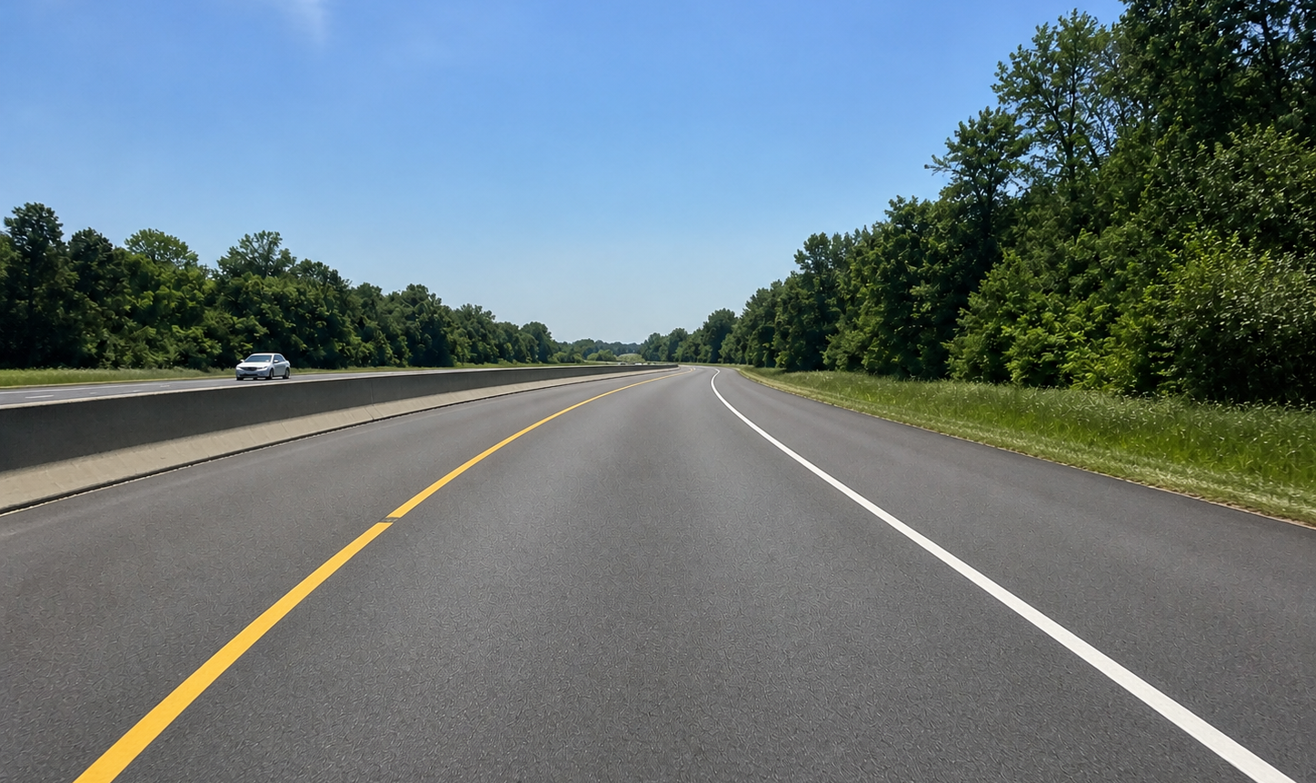
Curved lanes: collect pixels, then fit x(y)
CURVED LANES
Canny + color
road ROI
split left/right
polyfit
x=ay²+by+c
Sample y values → evaluate x(y) → draw two smooth polylines
The curve fit is still classical: every assumption and parameter is chosen by us.
Notes:
The color mask stabilizes white and yellow lane evidence in this controlled input. Fit x as a function of y because each image row should intersect each boundary once in the ROI.
[Sources]
- /media/william/blueicedrive/Github/Intro2AV-CourseContent/2026/Labs/ClassicalCV/student/inputs/road_curved.png
- /media/william/blueicedrive/Github/Intro2AV-CourseContent/2026/Labs/ClassicalCV/answers/ws/src/cv_lab/cv_lab/lane_detector_node.py

Slide 32
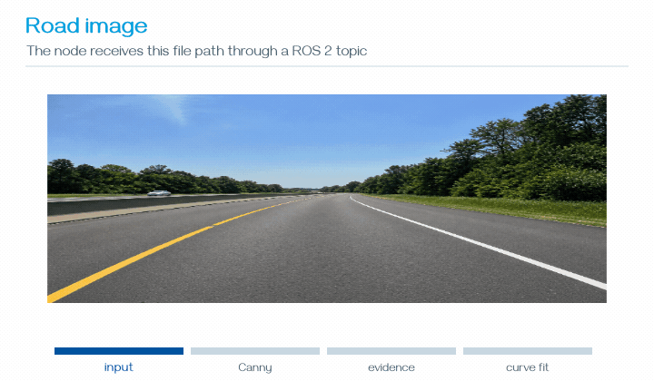
Hands-on 7: change a ROS parameter and publish the curved road
HANDS-ON CHECKPOINT
CONFIRM: the Hands-on 6 node is stopped
EDIT: ws/src/cv_lab/cv_lab/lane_detector_node.py
TODO: CURVE-CV
CURVE-CV → rebuild + source → run 1–5.
# 1) TERMINAL 1 — start the rebuilt node; leave running
ros2 run cv_lab lane_detector_node --ros-args \
-p output_dir:="$PWD/outputs"
# 2) TERMINAL 2 — select curved mode; verify it
ros2 param set /lane_detector mode curved
ros2 param get /lane_detector mode
# 3) TERMINAL 2 — wait for one curved-lane report
ros2 topic echo --once /perception/lane_report
# 4) TERMINAL 3 — publish road_curved.png
ros2 topic pub --once /perception/road_image_path \
std_msgs/msg/String "{data: '$PWD/inputs/road_curved.png'}"
# 5) FINISH — view PNG; Ctrl+C in Terminal 1
Parameter value: curved • Echo contains fitted_curves=2 • Open outputs/lane_curved.png
Notes:
Students confirm that the straight-lane process from Hands-on 6 is stopped so they do not run two lane_detector nodes. They edit CURVE-CV at the exact path shown, rebuild cv_lab, source the rebuilt workspace, and start the rebuilt node. Terminal 2 selects and verifies curved mode before waiting for one report. Terminal 3 publishes inputs/road_curved.png. The verified report contains fitted_curves=2. Step 5 stops Terminal 1 after viewing the visualization.
[Sources]
- https://docs.opencv.org/4.x/da/d22/tutorial_py_canny.html
- /media/william/blueicedrive/Github/Intro2AV-CourseContent/2026/Labs/ClassicalCV/student/ROS2_HANDS_ON.md
- /media/william/blueicedrive/Github/Intro2AV-CourseContent/2026/Labs/ClassicalCV/student/inputs/road_curved.png
- /media/william/blueicedrive/Github/Intro2AV-CourseContent/2026/Labs/ClassicalCV/student/ws/src/cv_lab/cv_lab/lane_detector_node.py
- /media/william/blueicedrive/Github/Intro2AV-CourseContent/2026/Labs/ClassicalCV/student/outputs/lane_curved.png

Slide 33
Classical perception ends with an interpretable chain
SYNTHESIS
pixels
x/y
counts
mask
repair
edge
maps
Canny +
Hough
line / curve
models
Strength
Cost
Next lecture
every stage is visible and debuggable
each variation needs another assumption
learn features with CNNs; model wider context with transformers
We did not eliminate failure—we made each failure explainable enough to motivate the next model.
Notes:
End the classical section here. Review the precise chain: projection collisions expose lost arrangement; selected local defects motivate morphology; remaining lost boundary arrangement motivates local edge maps; a slanted-digit failure motivates Sobel/Canny; Hough groups straight pieces only; straight-lane limits motivate curve fitting. Translation is handled separately by alignment. CNNs and transformers begin in the separate deck.
[Sources]
- https://docs.opencv.org/4.x/d9/d61/tutorial_py_morphological_ops.html
- https://docs.opencv.org/4.x/d2/d2c/tutorial_sobel_derivatives.html
- https://docs.opencv.org/4.x/da/d22/tutorial_py_canny.html
- https://docs.opencv.org/4.x/d9/db0/tutorial_hough_lines.html
- /media/william/blueicedrive/Github/Intro2AV-CourseContent/2026/Labs/ClassicalCV/student/README.md

